Slide 1


BVRIT HYDERABAD College of Engineering for Women Department of Computer Science and Engineering
Gait process analysis for neuro disease using ensemble techniques
Under the Guidance of:
Name: Ms. Shanmuga Sundari
Designation: Assistant Professor
Team No: 19
Shriya Sunku 19WH1A0576
M. Bhanupriya 19WH1A0593
V. Sarayu 19WH1A05A4

Slide 2
TABLE OF CONTENTS
Abstract
Introduction
Literature survey
Existing system
Drawbacks of existing system
Objective
Proposed system
Advantages
Architecture
Methodology
Evaluation metrics
Dataset
Results
Societal impact
Conclusion and Future work
References

Slide 3
ABSTRACT
Gait analysis and classification is often used as a clinical tool for detecting and diagnosing these diseases. With emerging machine learning techniques, automatic gait classification and disease diagnosis becomes an active research area in the field of intelligent healthcare and automation. Automatic gait measurement and analysis is an enabling tool for intelligent healthcare and robotics-assisted rehabilitation. To categorize whether individuals with neuro diseases were affected, a support vector machine-based classifier was created.

Slide 4
INTRODUCTION
Gait analysis is the study of human locomotion. In order to analyze and quantify how someone walks, it is necessary to isolate the shortest, unique, repeatable task during gait.
Gait disturbance is the common symptom in most neurological diseases.
Neuro diseases are the disorders that affect the brain as well as the nerves found throughout the human and spinal cord.
The most common neuro diseases are epilepsy, Alzheimer’s disease, Parkinson’s diseases, seizures and many more.

Slide 5
INTRODUCTION
Support vector machine or SVM is one of the most popular supervised learning algorithms which is used for classification and regression problems.
The goal of SVM algorithm is to create the best line for classifying the n-dimensional space into classes.
Ensemble methods are techniques that aim at improving the accuracy of results in models by combining multiple models instead of using a single model.
Our objective is to develop a gait phase classifier using ensemble techniques to determine whether an individual has any neuro diseases.

Slide 6
LITERATURE SURVEY
S.No | Title of the paper | Author(s) & Journal Details | Description/ Interpretation
1 | A new dataset for facial motion analysis in individuals with neurological diseases | Andrea Bandini, Diego L. Guarin, Madhura Kulkarni, Babak Taati IEEE journal of biomedical and health informatics, Vol. 25, No. 4, April 2021. | It has oro-facial feature videos to detect the neuro diseases in patients. Future work – Focusing on automatic detection of the features
2 | Robust Bayesian Analysis of Early-Stage Parkinson’s Disease Progression Using DaTscan Images | Yuan Zhou , Sule Tinaz, Hemant D. Tagare IEEE transactions on medical imaging, Vol. 40, No. 2, February 2021. | It aims at identifying the spatial progression patterns and their time constants . Future work - To work on the several other progression patterns.
3 | An Algorithmic Approach for Quantitative Evaluation of Parkinson's Disease Symptoms and Medical Treatment Utilizing Wearables and Multi-Criteria Symptoms Assessment | Tomasz Gutowski, Mariusz Chmielewski IEEE Access (Volume: 9), 03 February 2021 | This is a sensor-based disease symptom evaluation of Parkinson’s Disease. Future work – To record a wider spectrum and deliver the sensor data.
4 | Inertial Sensor Algorithms to Characterize Turning in Neurological Patients with Turn Hesitations | Vrutangkumar V. Shah , Carolin Curtze , Martina Mancini IEEE journal of biomedical engineering, Vol. 68, No. 9, September 2021. | Validate and determine the generalizability for discrete turn and merged turn algorithm. Future work - To work well with characterizing turns during free-living conditions

Slide 7
LITERATURE SURVEY
S.No | Title of the paper | Author(s) & Journal Details | Description/ Interpretation
5 | Development of Neuro-Degenerative Diseases’ Gait Classification Algorithm Using Convolutional Neural Network and Wavelet Coherence Spectrogram of Gait Synchronization | An-bang liu, Che- wei lin, IEEE Access Volume: 10, 11 April 2022 | Main purpose of this research was to help physicians with screening for NDD for early diagnosis, efficient treatment planning, and monitoring of disease progression. Future work – To obtain clinical data, NDD gait phenomenon based on time-frequency should be discussed.
6 | Predicting State Transition in Freezing of Gait via Acceleration Measurements for Controlled Cueing in Parkinson’s Disease | Abhishek Halder Ashish Suri, IEEE Transactions on instrumentation and measurement, Volume 70,2021 | Attempt to develop a machine learning approach for the prediction of start and termination of freezing, which can potentially provide automated controlled cueing in Parkinson’s individuals. Future work – Focusing on gender based work.
7 | Parkinson’s Disease Management via Wearable Sensors: A Systematic Review | Abdul Rehman Javed, Natalia Kryvinska Volume: 10, 28 March 2022 | Paper presents a Systematic Literature Review (SLR) that provides an in-depth analysis of the PD symptoms, Motor and Non-Motor Symptoms (NMS). Future work – Testing and feasibility design in real-world scenarios.
8 | Diabetic Sensorimotor Polyneuropathy Severity Classification Using Adaptive Neuro Fuzzy Inference System | Norhana Arsad Sawal H. M. Ali IEEE Access(Volume: 9), 01 January 2021 | Study aims to depict an intelligent DSPN severity classifier using Adaptive Neuro Fuzzy Inference System (ANFIS). Future work – Focusing on more clear and subjective screening processes.

Slide 8
LITERATURE SURVEY
S.No | Title of the paper | Author(s) & Journal Details | Description/ Interpretation
9 | Analysis of Brain Functional Network Based on EEG Signals for Early-Stage Parkinson’s Disease Detection | Wei Zhang, Xiaoxuan Han, Shujuan Qiu,Teng Li IEEE Access (Volume: 10), 09 February 2022 | Scalp EEG detection method has been used to solve the difficult problem of early diagnosis of Parkinson’s disease. Future work – To work on specific brain network activities.
10 | Looking Disease in the Eye | Jim Banks IEEE Pulse ( Volume: 12, Issue: 6 , Nov.-Dec. 2021) | It aims at methods to cure the loss of vision.
11 | Longitudinal Pooling & Consistency Regularization to Model Disease Progression From MRIs | Jiahong Ouyang , Qingyu Zhao, Edith V. Sullivan , Adolf Pfefferbaum IEEE journal of biomedical and health informatics, Vol. 25, No. 6, June 2021. | To avoid the issue of diagnosis for neurological disease , coupling feature extraction is used. Future work – Fusing information from multi –modality inputs, using high resolution images.
12 | Lacsogram: A New EEG Tool to Diagnose Alzheimer’s Disease | Pedro M. Rodrigues , Bruno C. Bispo , Carolina Garrett, Dílio Alves IEEE journal of biomedical and health informatics, Vol. 25, No. 9, September 2021. | A lacsogram tool is used to characterize the Alzheimer’s disease (AD). Future work – Using larger population to ensure consistent generalization.

Slide 9
EXISTING SYSTEM
For the purpose of analyzing neuro disorders, it uses a support vector machine-based classifier to distinguish between various gait patterns. To comprehend the patient's state, all patterns are observed. This aids in determining the patient's neurological illnesses.

Slide 10
DRAWBACKS
Despite the fact that the chosen gait patterns performed well, the selection process has to be improved.
Misclassification of the patterns used to analyze neuro diseases is another problem.
Another problem is not taking the variance parameter into account.

Slide 11
OBJECTIVE
To understand how different gait patterns should be used in this type models, distinct gait patterns must be thoroughly analysed. Utilising Linear regression and taking the variance parameter into account

Slide 12
PROPOSED SYSTEM
With the use of ensemble approaches, the suggested system analyses the gait phase to classify neuro disorders. We can guarantee superior performance with increased efficiency and effectiveness by applying ensemble approaches.

Slide 13
ADVANTAGES
Good performance
Increased efficiency
Higher effectiveness

Slide 14
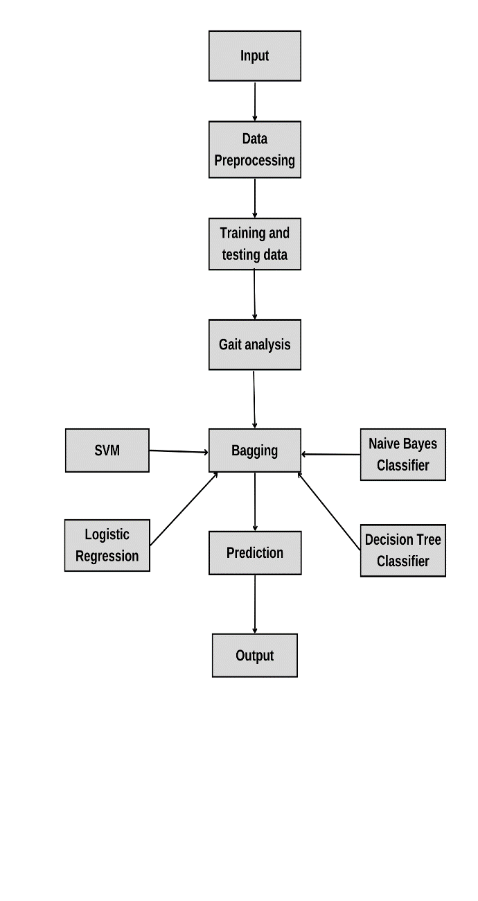
ARCHITECTURE

Slide 15
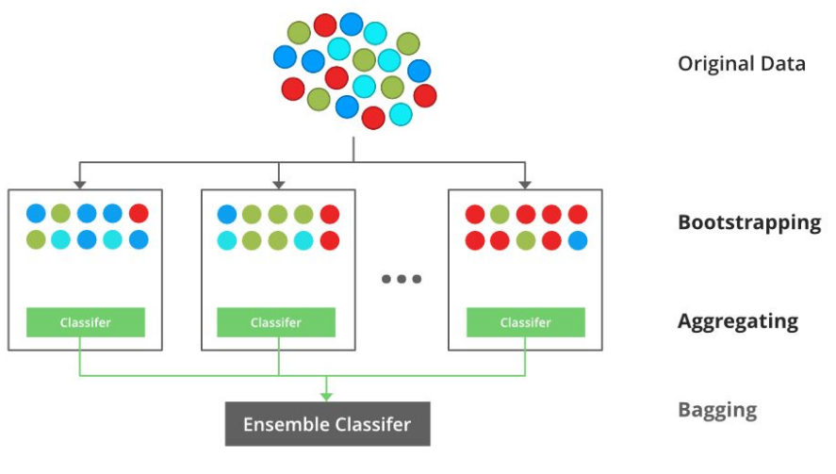
METHODOLOGY

Slide 16
METHODOLOGY
Support Vector Machine or SVM is one of the most popular supervised learning algorithms, which is used for classification as well as regression problems.
The goal of the SVM algorithm is to create the best line or decision boundary that can segregate n-dimensional space into classes.
This is done so that it will be simple to classify the new data point in the future. This best decision boundary is called a hyperplane.
SVM chooses the extreme points/vectors that help in creating the hyperplane. These extreme cases are called as support vectors, and hence algorithm is termed as Support Vector Machine.

Slide 17
METHODOLOGY
Ensemble methods aim at improving predictability in models by combining several models to make one very reliable model.
The most popular ensemble methods are boosting, bagging, and stacking. We will be using bagging algorithms such as Naïve Bayes Classifier, Decision Tree Classifier and Logistic Regression
Ensemble methods are ideal for regression and classification, where they reduce bias and variance to boost the accuracy of models.

Slide 18
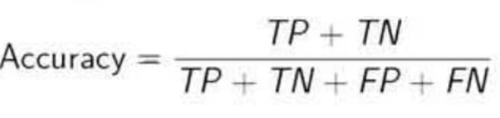
EVALUATION METRICS
Confusion matrix
It is a performance measurement for machine learning classification problem where output can be two or more classes. It is a table with 4 different combinations of predicted and actual values.
Actual values
Positive(1)
Negative(0)
Positive(1)
TP
FP
Predicted values
Negative(0)
FN
TN

Slide 19
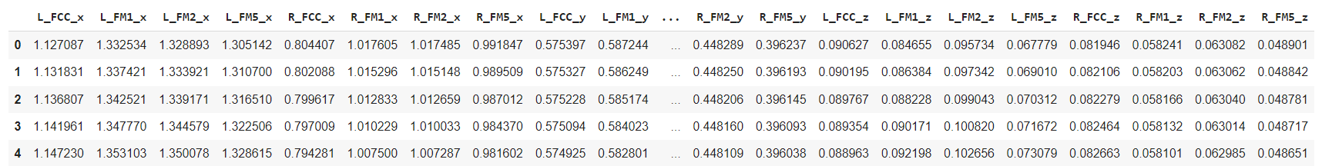
DATASET
Number of attributes: 24
Dataset link: https://www.kaggle.com/code/dasmehdixtr/classiffier-examples-on-gait-phase-dataset/data?select=data
Dataset

Slide 20
RESULTS
Algorithms | Accuracy
SVM | 88.34
Naïve Bayes Classifier | 81.11
Logistic Regression | 86.84
KNN | 93.74
Bagging | 97.69

Slide 21
SOCIETAL IMPACT
This project aids all medical facilities in their analysis of patients’ various neuro diseases.
It will be a big help to all the clinicians in understanding the issues faced by patients with neuro diseases.
This will enable many people to live longer and healthier lives.

Slide 22
CONCLUSION AND FUTURE WORK
In this effort, a brand-new approach to classifying neuro disorders using gait phase analysis was developed. Support vector machines were first employed for the analytical procedure. Then, for improved effectiveness and efficiency, ensemble techniques were applied. The method offers a lot of potential for additional uses in diagnosis, healthcare, and robotics-assisted rehabilitation.
There are several neurodiseases, and as each disease manifests itself differently, numerous feature extractions must be performed in the future in order to improve the model's accuracy.
Extending the various sets of gait parameters will also be a major focus of future study in order to decrease Misclassification and increase accuracy

Slide 23
REFERENCES
[1] FEBRYAN SETIAWAN 1, AN-BANG LIU2, AND CHE-WEI LIN, “Development of Neuro-Degenerative Diseases' Gait Classification Algorithm Using Convolutional Neural Network and Wavelet Coherence Spectrogram of Gait Synchronization”, Volume: 10, 11 April 2022
[2] Abhishek Halder, Ramandeep Singh, Ashish Suri, and Deepak Joshi, “Predicting State Transition in Freezing of Gait via Acceleration Measurements for Controlled Cueing in Parkinson’s Disease”, IEEE TRANSACTIONS ON INSTRUMENTATION AND MEASUREMENT, VOL. 70, 2021
[3] HUMA MUGHAL, ABDUL REHMAN JAVED, MUHAMMAD RIZWAN, AHMAD S. ALMADHOR, AND NATALIA KRYVINSKA, “Parkinson's Disease Management via Wearable Sensors: A Systematic Review”, Volume: 10, 28 March 2022
[4] Xiaoyu Guo , Borong He , Kelvin Y. S. Lau, Peter P. K. Chan, Richard Liu, Jodie J. Xie , Sophia C. W. Ha, Chao-Ying Chen , Gladys L. Y. Cheing , Roy T. H. Cheung , Rosa H. M. Chan , Senior Member, IEEE, and Vincent C. K. Cheung ,” Age-Related Modifications of Muscle Synergies and Their Temporal Activations for Overground Walking”, IEEE TRANSACTIONS ON NEURAL SYSTEMS AND REHABILITATION ENGINEERING, VOL. 30, 2022
[5] FAHMIDA HAQUE, MAMUN B. I. REAZ, (Senior Member, IEEE), MUHAMMAD E. H. CHOWDHURY, (Senior Member, IEEE), FAZIDA H. HASHIM, NORHANA ARSAD, (Senior Member, IEEE), AND SAWAL H. M. ALI, (Member, IEEE), “Diabetic Sensorimotor Polyneuropathy Severity Classification Using Adaptive Neuro Fuzzy Inference System”, IEEE Access (Volume: 9), 01 January 2021
[6] WEI ZHANG, XIAOXUAN HAN, SHUJUAN QIU, TENG LI, CHUNGUANG CHU, LIUFANG WANG, JIANG WANG, (Member, IEEE), ZHEN ZHANG, (Senior Member, IEEE), RUIXIAN WANG, MANYI YANG, XIAO SHEN, ZHEN LI, LIPENG BAI, ZHUO LI, RUI ZHANG, YANLIN WANG1, CHEN LIU ,(Member, IEEE), AND XIAODONG ZHU, “Analysis of Brain Functional Network Based on EEG Signals for Early-Stage Parkinson's Disease Detection”, IEEE Access (Volume: 10), 09 February 2022
[7] Jiahong Ouyang , Qingyu Zhao, Edith V. Sullivan , Adolf Pfefferbaum , Susan F. Tapert , Ehsan Adeli , Member, IEEE, and Kilian M. Pohl, “Longitudinal Pooling & Consistency Regularization to Model Disease Progression From MRIs”, IEEE JOURNAL OF BIOMEDICAL AND HEALTH INFORMATICS, VOL. 25, NO. 6, JUNE 2021
[8] Pedro M. Rodrigues , Bruno C. Bispo , Carolina Garrett, Dílio Alves, João P. Teixeira , and Diamantino Freitas, “Lacsogram: A New EEG Tool to Diagnose Alzheimer’s Disease”, IEEE JOURNAL OF BIOMEDICAL AND HEALTH INFORMATICS, VOL. 25, NO. 9, SEPTEMBER 2021

Slide 24
REFERENCES
[9] ABOL BASHER, BYEONG C. KIM, KUN HO LEE, AND HO YUB JUNG, “Volumetric Feature-Based Alzheimer's Disease Diagnosis From sMRI Data Using a Convolutional Neural Network and a Deep Neural Network”, IEEE Access (Volume: 9), 16 February 2021
[10] Andrea Bandini , Member, IEEE, Sia Rezaei , Diego L. Guarín, Madhura Kulkarni , Derrick Lim, Mark I. Boulos, Lorne Zinman, Yana Yunusova , and Babak Taati, “ A New Dataset for Facial Motion Analysis in Individuals With Neurological Disorders”, IEEE JOURNAL OF BIOMEDICAL AND HEALTH INFORMATICS, VOL. 25, NO. 4, APRIL 2021
[11] Yuan Zhou , Member, IEEE, Sule Tinaz, and Hemant D. Tagare, Senior Member, IEEE, “Robust Bayesian Analysis of Early-Stage Parkinson’s Disease Progression Using DaTscan Images”, IEEE TRANSACTIONS ON MEDICAL IMAGING, VOL. 40, NO. 2, FEBRUARY 2021
[12] TOMASZ GUTOWSKI AND MARIUSZ CHMIELEWSKI, “An Algorithmic Approach for Quantitative Evaluation of Parkinson's Disease Symptoms and Medical Treatment Utilizing Wearables and Multi-Criteria Symptoms Assessment”, IEEE Access (Volume: 9), 03 February 2021
[13] Vrutangkumar V. Shah , Carolin Curtze , Martina Mancini , Member, IEEE, Patricia Carlson-Kuhta , John G. Nutt, Christopher M. Gomez, Mahmoud El-Gohary, Fay B. Horak , and James McNames , Senior Member, IEEE, “Inertial Sensor Algorithms to Characterize Turning in Neurological Patients With Turn Hesitations”, IEEE TRANSACTIONS ON BIOMEDICAL ENGINEERING, VOL. 68, NO. 9, SEPTEMBER 2021
[14] Samhwan Kim, Seongtak Kang , Jinmo Kim, Doyoung Lee, Graduate Student Member, IEEE, Sanghee Kim, Junghyup Lee , Senior Member, IEEE, Kyung-In Jang, Yong-Seok Oh , Jong-Cheol Rah , Man Seung Huh, Sun Ha Paek, and Ji-Woong Choi , Senior Member, IEEE, “Closed-Loop Neuromodulation for Parkinson’s Disease: Current State and Future Directions”, IEEE TRANSACTIONS ON MOLECULAR, BIOLOGICAL, AND MULTI-SCALE COMMUNICATIONS, VOL. 7, NO. 4, DECEMBER 2021

Slide 25
THANK YOU

